Slide 1


Offuture- Sales Performance
Photo by Nastuh Abootalebi on Unsplash

Slide 2


Agenda
Overview of performance
Profit per year/ quarter
Profit per month and weekday
Category breakdown
Quantities sold per Category/ Sub-Category
Highlighting anomalies
Demographic Performance
Sales/ Profit by Region
Sales/ Profit by Market
Photo by Redd F on Unsplash

Slide 3
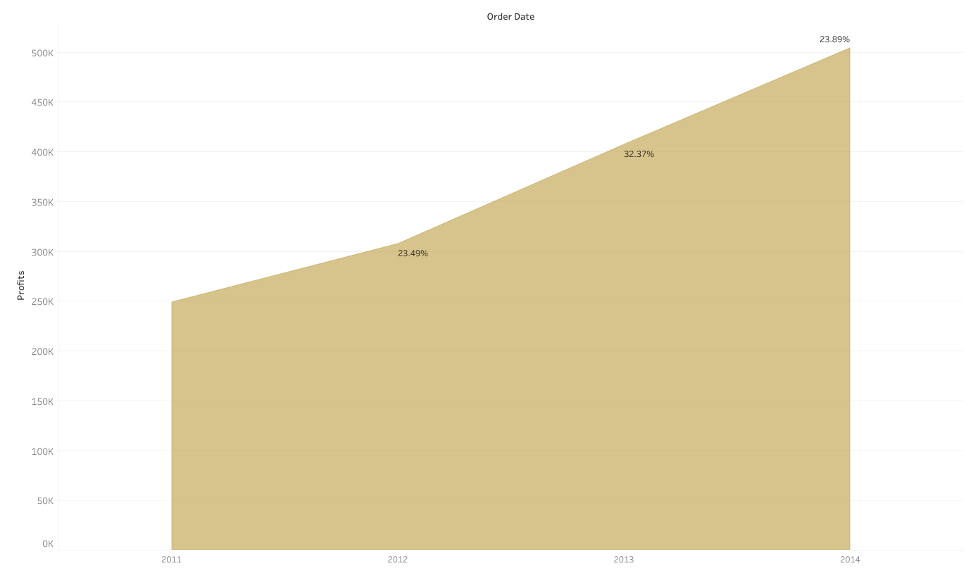
Profit per Year
Overview
26.58% Avg Increase year on year
Doubled profits from 2011-2014

Slide 4
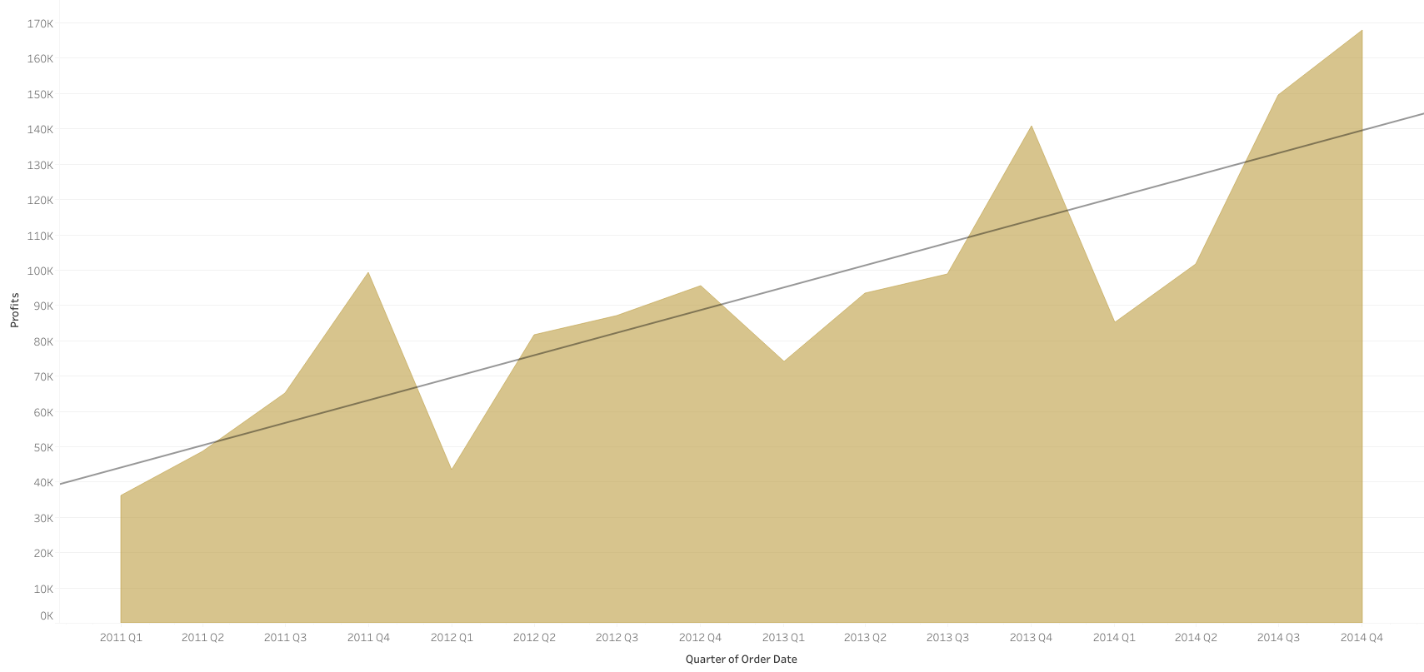
Profit per Quarter
Overview

Slide 5
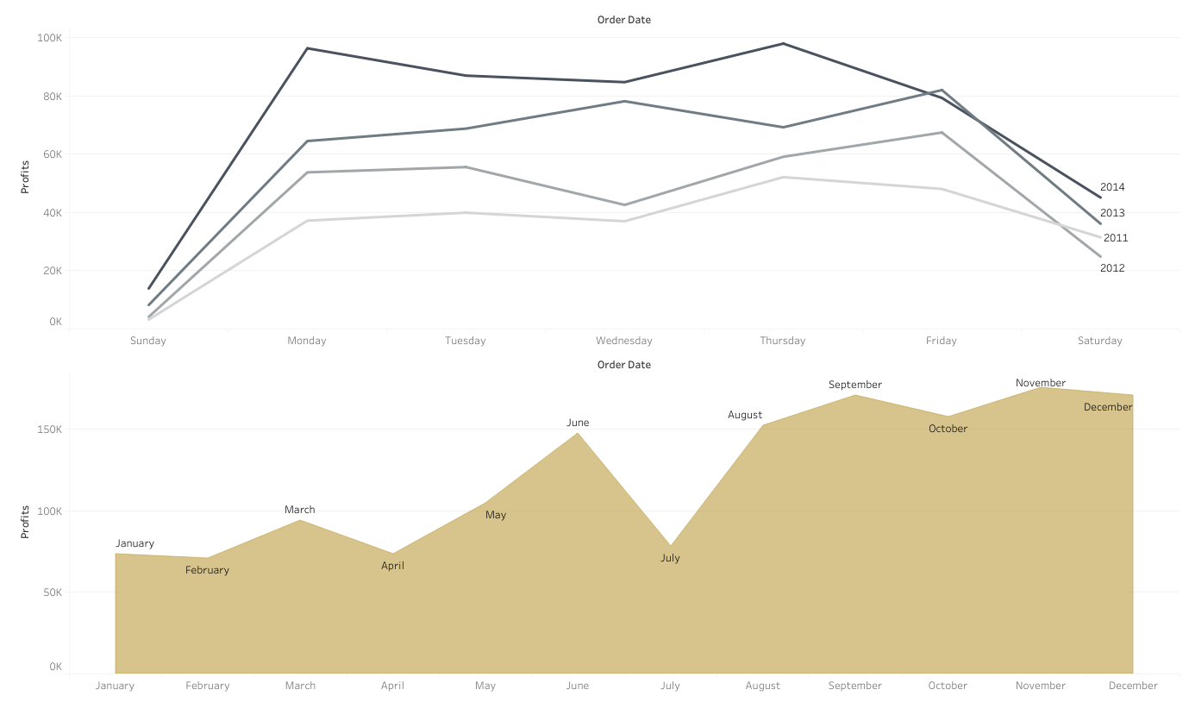
Profits per Weekday and Month
Overview

Slide 6

Categories
Photo by Domingo Alvarez E on Unsplash

Slide 7
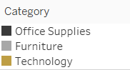
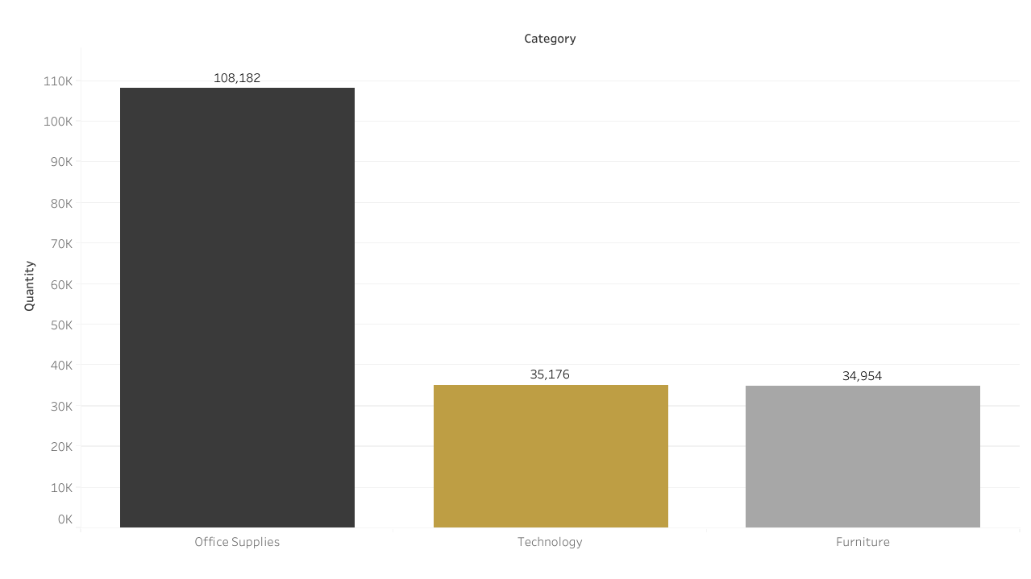
Quantity Sold per Category
2 - Categories

Slide 8
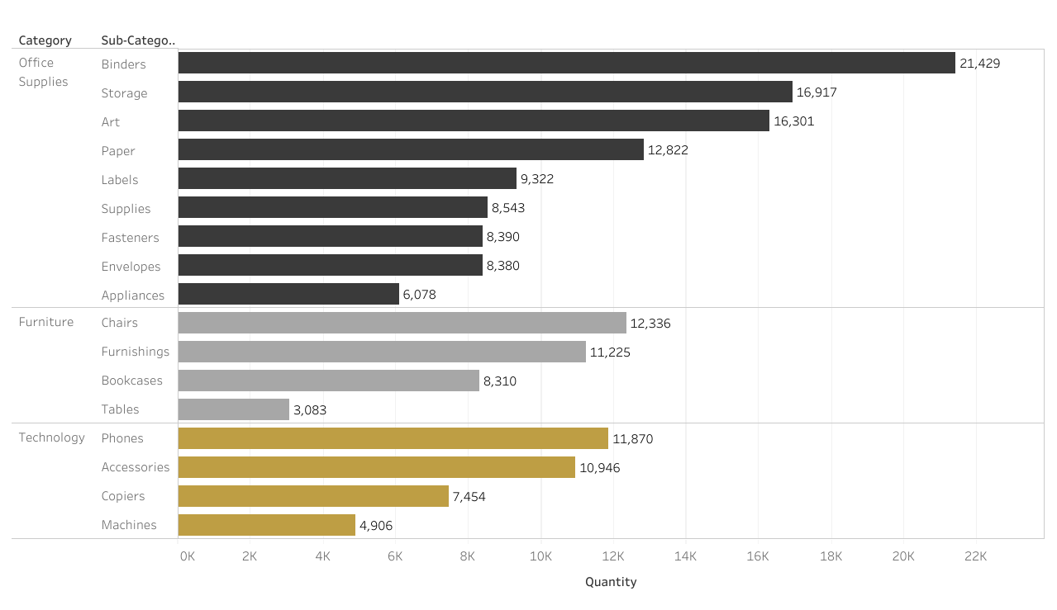
Quantity Sold per Sub-Category
2 - Categories

Slide 9
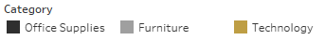
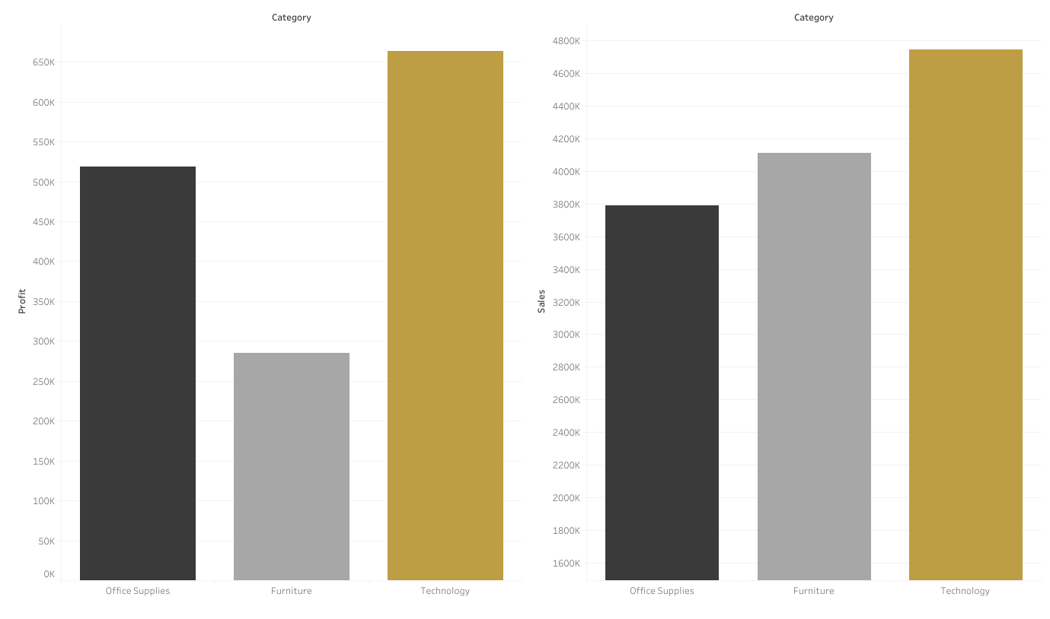
Profit and Sales per Category
2 - Categories

Slide 10
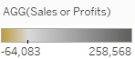
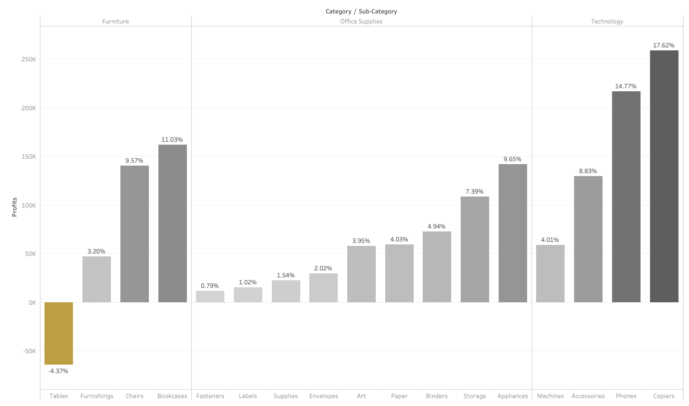
Profit per Sub-category
2 - Categories

Slide 11
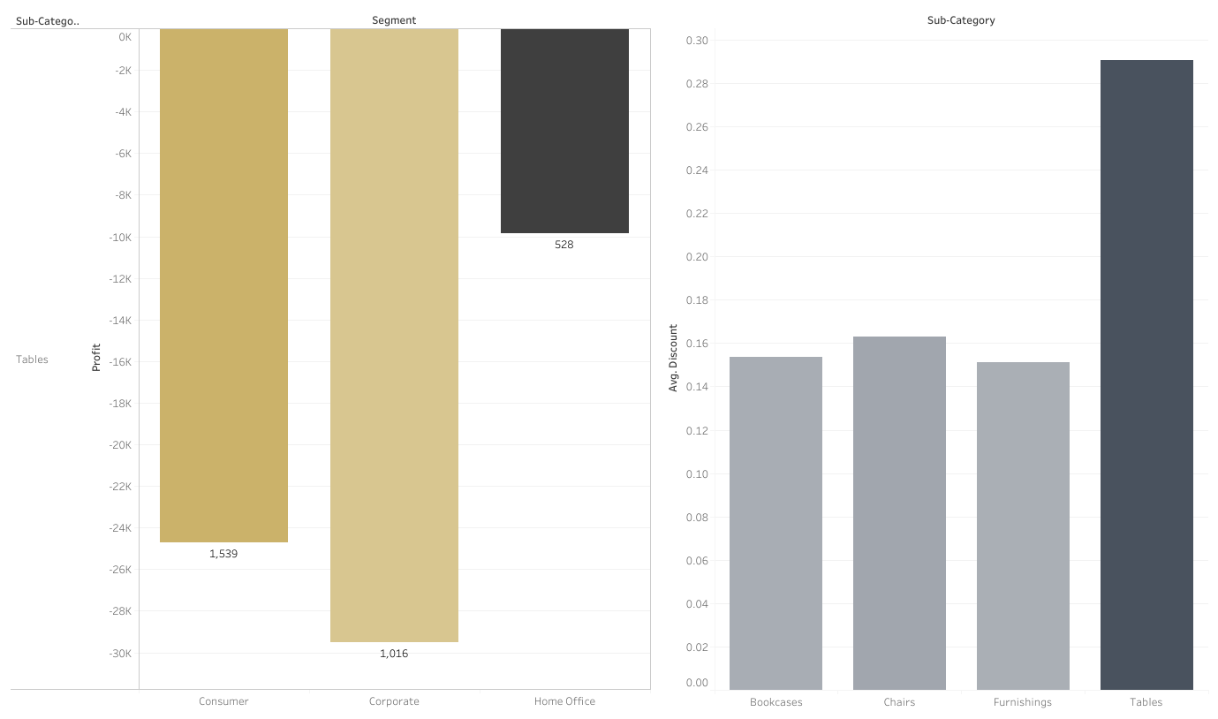
2 - Categories
Table Losses per Segment
AVG Discount by Sub-Category

Slide 12
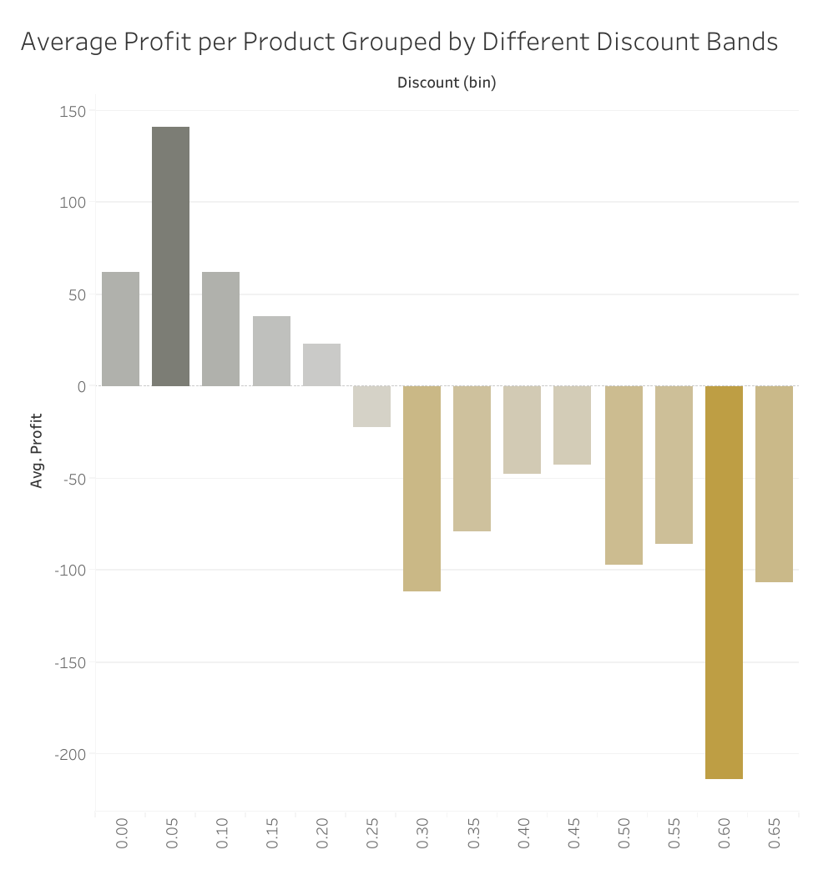
Average Profit per Product for Different Discount Bands
2 - Categories
Products with a larger discount generate less profit on average
The cutoff point for profitable discounts seems to be around 30%

Slide 13

Demographic Performance
Photo by Clay Banks on Unsplash

Slide 14
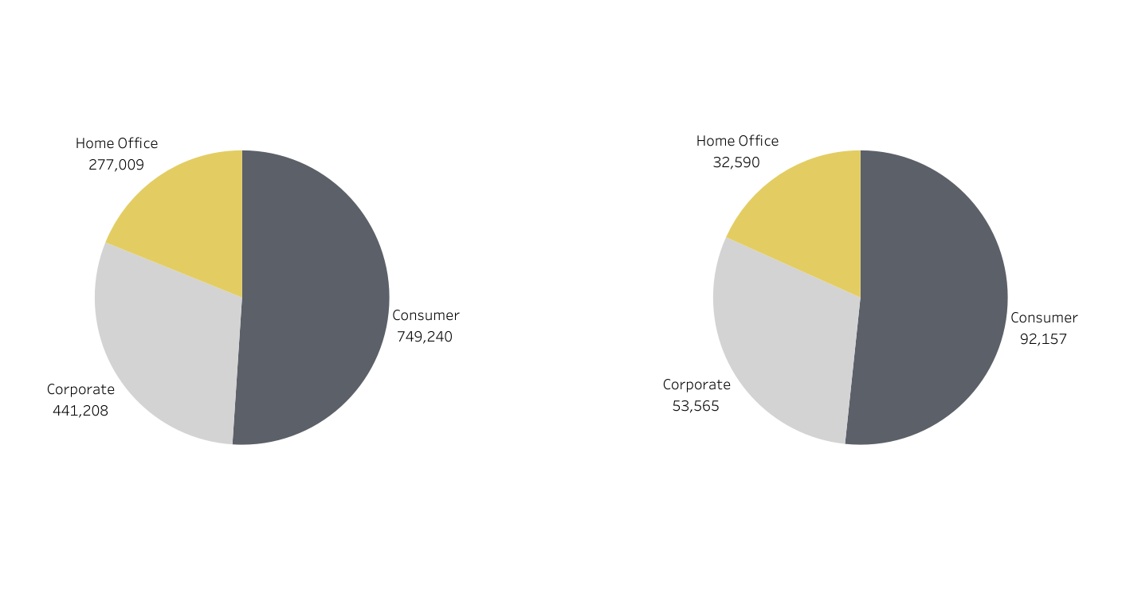
Profit Generated per Segment
3 - Demographics
Volume of Sales per Segment

Slide 15
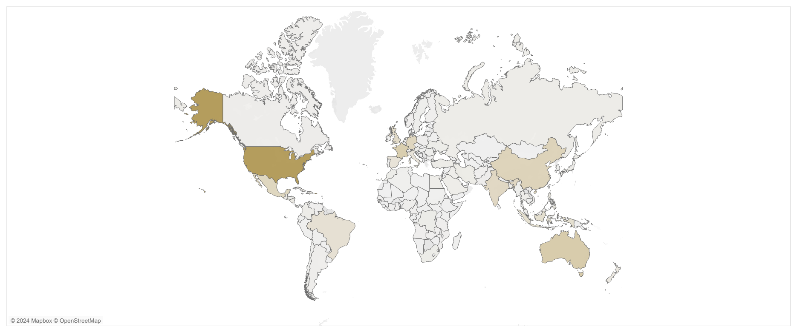
3 - Demographics
Total Sales across Countries

Slide 16
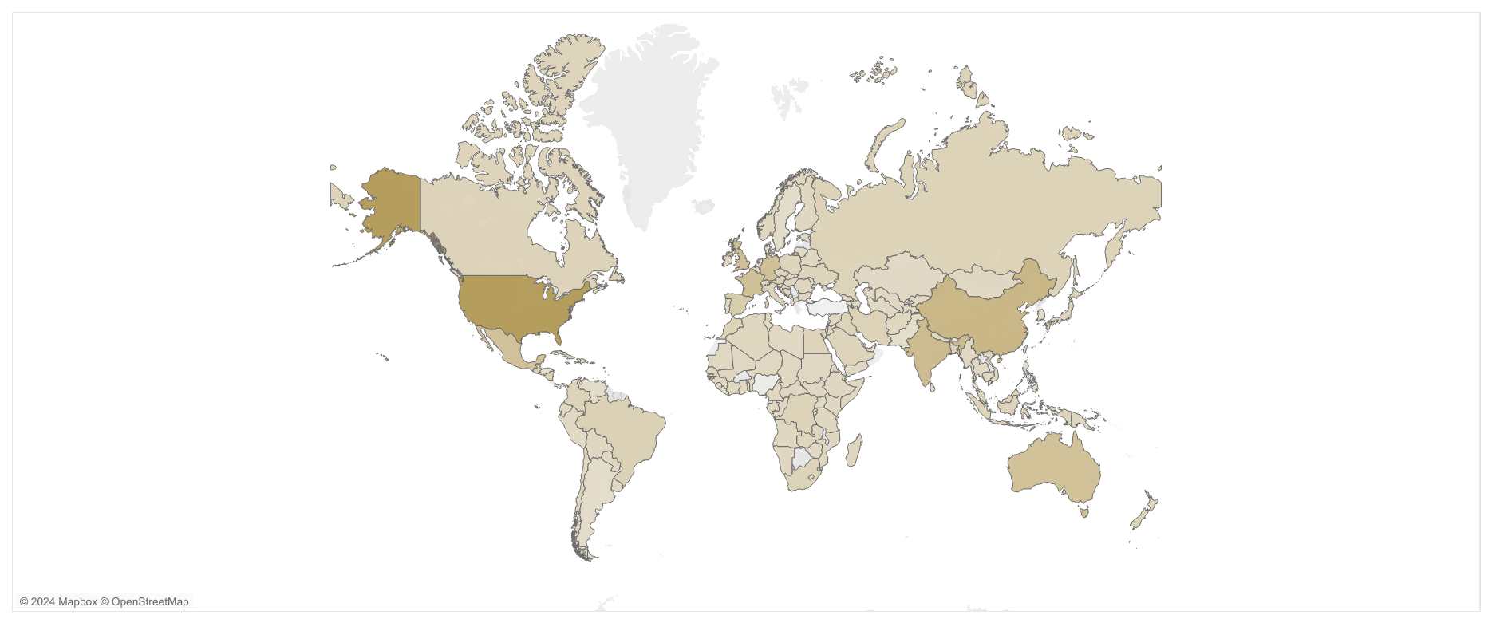
3 - Demographics
Total Profit across Countries

Slide 17
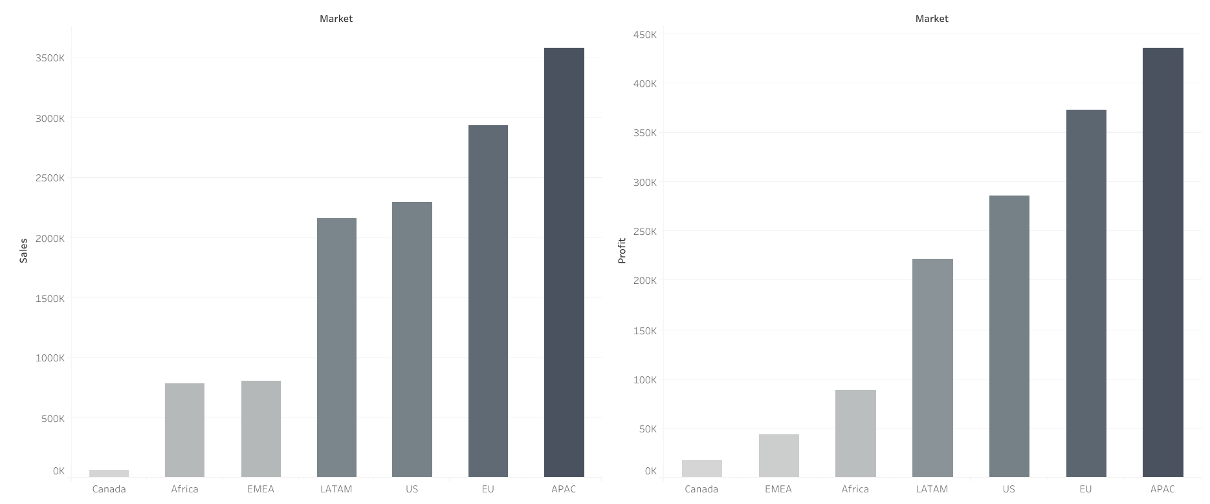
3 - Demographics
Sales and Profit across Market

Slide 18
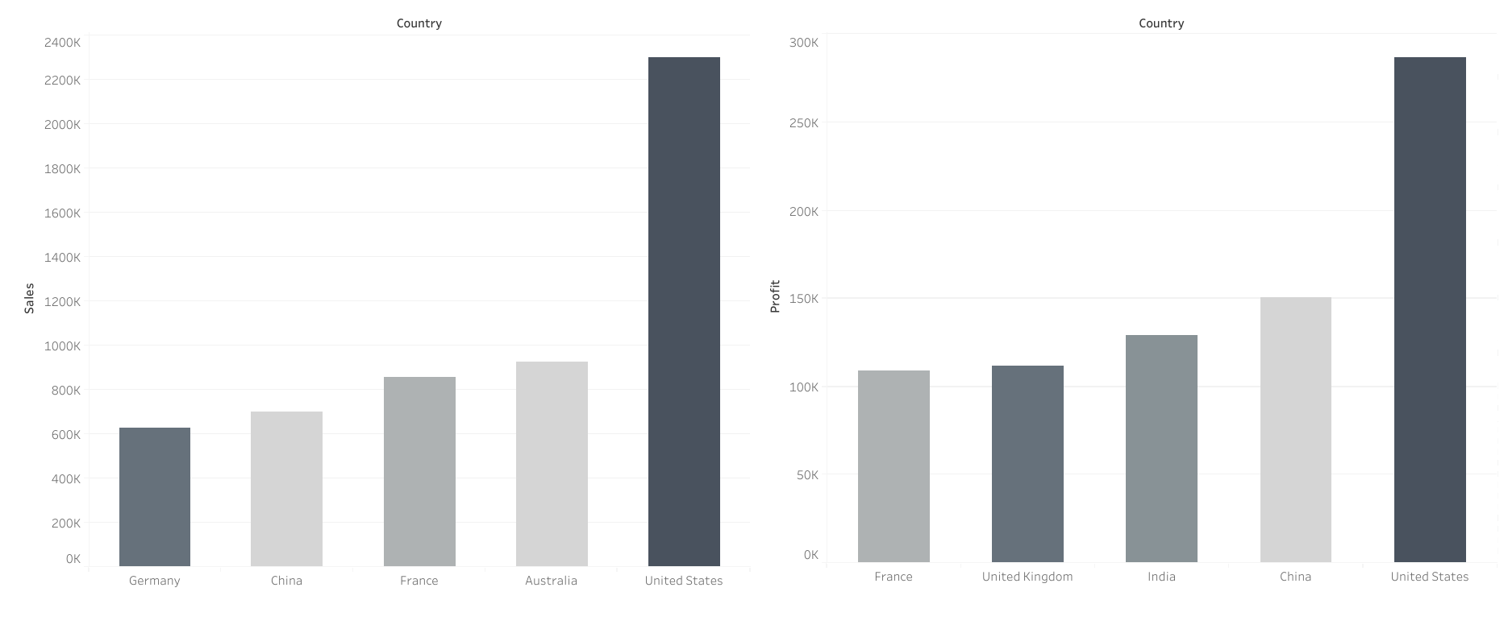
Top 5 Countries - Sales and Profit
3 - Demographics

Slide 19
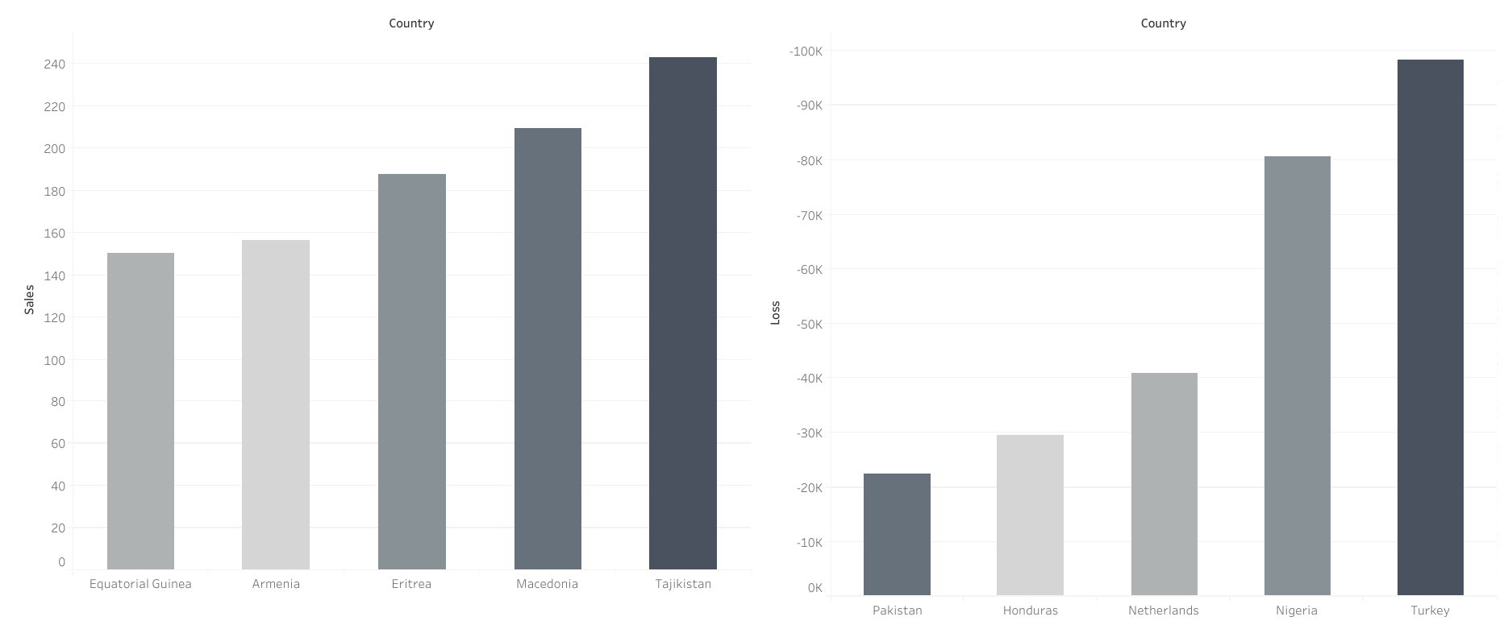
Bottom 5 Countries - Sales and Loss
3 - Demographics

Slide 20

Questions?

